Slide 1

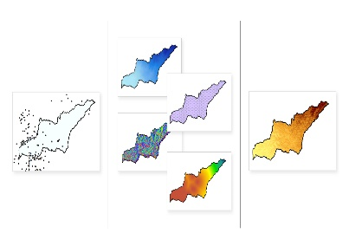
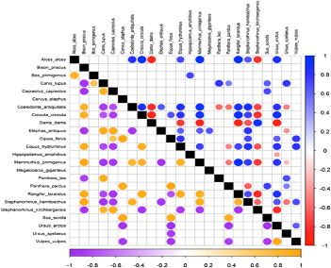
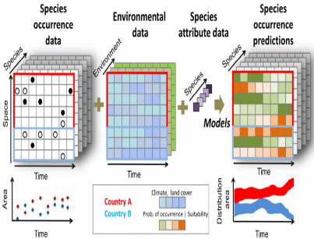
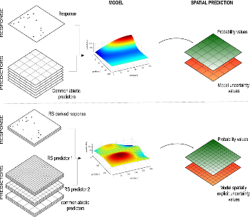
Registration Form
CHIEF PATRON
Prof. Rakesh Bhatnagar
Vice Chancellor - BHU
Name: Dr./Mr./Ms. /Mrs.
______________________________________________
Designation: ___________________________________
Date of Birth: _________________________________
College/Organization Name: ______________________
Address for correspondence: _____________________
______________________________________________
Pin Code:______________________________________
Mobile Number:________________________________
Email:________________________________________
Payment Details: ______________________________
DD No.: ______________________________________
Bank Name: ___________________________________
Amount : _____________________________________
Date: _________________________________________
Area of Interest ________________________________
Why do you want to attend this workshop ______________________________________________
______________________________________________
Signature: _____________ Date:______________
Online Workshop on Species Distribution Modelling Using R
15th – 16th March, 2021
PATRON
Prof. A S Raghubanshi
Director- IESD, BHU, Varanasi
ORGANIZING SECRETARY
Dr. Prashant K. Srivastava
IESD, BHU, Varanasi
ORGANIZING COMMITTEE
Prof. G. S. Singh
Prof. Kavita Shah
Prof. R. K. Mall
Dr. J P Verma
Dr. Sunita Verma
Dr. V. Mishra
Dr. Rajiv Pratap Singh
Dr. P C Abhilash
Dr. T Banerjee
Dr. Kirpa Ram
Dr. Sudhakar Srivastava
Dr. Vishal Prasad
Organized By
“The greatest threat to our planet is the belief that someone else will SAVE it!”
-Robert Swan
Institute of Environment
& Sustainable Development,
Banaras Hindu University, Varanasi
Contact email: workshopiesd@gmail.com
Contact Number: +91- 7571927744

Slide 2
ABOUT INSTITUTE
Banaras Hindu University is an internationally reputed temple of learning, situated in the holy city of Varanasi. This Creative and innovative university was founded by the great nationalist leader, Pandit Madan Mohan Malviya, in 1916 with cooperation of great personalities like Dr Annie Besant. Banaras Hindu University was created under the Parliamentary legislation (B.H.U. Act 1915). It has developed into the greatest center of learning in India. The Institute of Environment & Sustainable Development is dedicated to a better understanding of critical scientific and social issues related to sustainable development goals through guided research. The institute is making its mark at the national and international platforms in a number of frontier areas of Environment Science like hydrometeorology & agrometeorology, climate research, Remote sensing and GIS, modelling air pollution, water resources etc.
WORKSHOP TOPICS
Introduction to Forest Ecology and Species Distribution.
Basics of R and its packages
Introduction to species distribution modelling
Hands on in Species Distribution modelling using R
IMPORTANT DATES
Registration deadline | 6th March, 2021
Confirmation of Participation | 12th March, 2021
*Registration seats are limited (First Come First Serve Basis)
CATEGORY OF DELEGATES | Amount (INR)
PG Students | ₹ 400
Research /Ph.D. Scholar | ₹ 600
Govt./Autonomous Bodies /PSU /Industry/NGO | ₹ 1000
ABOUT VARANASI
Varanasi, the spiritual capital of India, is believed to be the most ancient surviving city of the globe. Legend has it that the first Siva Jyotirlinga emanated from the earth in this city and flared straight into the sky. This is why Varanasi is also known as Kashi or “The City of Light”. The boat rides on the Ganga, visiting the different temples and exploring the vibrant city is made double fun for visitors.
ABOUT WORKSHOP
Modelling species’ environmental requirements and mapping their distributions through space and time constitute important aspects of many biological analyses, particularly in support of conservation and management interventions. Species distribution models (SDM) use known locations of a species and information on environmental conditions to predict species distributions. SDM use a variety of algorithms to estimate relationships between species locations and environmental conditions, predict and map habitat suitability. SDMs represent a set of popular techniques for interpolating and extrapolating species distributions based on quantitative or rule‐based models. This workshop will also cover the demonstrations and hands-on training on software R.
The payment can be made through cash/electronic transfer/DD/Cheque. DD/Cheque and completely filled registration form along with CV should be sent to Dr. P. K. Srivastava, Organizing Secretary, Institute of Environment and Sustainable Development, Banaras Hindu University, Varanasi at the email id: workshopiesd@gmail.com. Bank details for the electronic transfer are given below:
For any enquiry or further information please contact
Organizing Secretary
Online Workshop on Species Distribution Modelling Using R
Banaras Hindu University,
Varanasi-221005.
Mobile No: +91-7571927744
Email id: : workshopiesd@gmail.com
Bank Details
Account Name: Organizing Secretary Hypertech workshop IESD
Account No.: 27790200000612
IFSC Code: BARB0BHUVAR
Bank Name: Bank of Baroda (BHU, Varanasi)

